Slide 1
Stewarding Your Body
Yahweh’s Design for Health and Longevity
Notes:
I’m praying that what I’m about to share is the truth…not just another influencer attempt at presenting a fad diet.

Slide 2
Health & Fertility Issues in America
Life-Threatening Chronic Diseases are on the rise
  Over the next 30 years diagnosis rates will increase:
    Cancer – 77%
    Diabetes – 39%
    Cardiovascular Disease – 27%
    Obesity – 18%
Fertility Rates are at an all time low
  One in six people experience infertility
  Miscarriage rates are increasing
  USA is now below the population replacement rate
  Believed that world-wide population decline will cause some countries to become extinct by 2100

Slide 3
Longevity – America vs. God’s Intent
USA life span statistic has shown a decline in last 20 yrs and is now only 76.4 years
After the flood Yahweh established that man should live 120 years (Gen. 6:3)
Moses was still healthy when he died at age 122 (Deut 37:4)
Caleb was still as strong at age 85 as when he was 40 (Joshua 14:11)
Note that Ps 90:10 also makes a statement about longevity where 80 years is considered the best we can hope for. It is important to note that this is a Psalm written by a man as opposed to the recorded word of God in Gen 6:3. It is interesting that it is believed Ps 90 was written by Moses when in the wilderness surrounded by people who would providentially die before they entered the promised land!! However, Moses himself lived to 122.

Slide 4

Our Current Health Care System
We have one of the most advanced health care systems in the world
High rise medical campuses with expensive state-of-the-art eq’t
Highly trained medical specialists
A constantly moving target about diet and lifestyle. For example, when I was young there were advertisements showing doctors recommending that if you smoked a particular cigarette brand you would be healthier!
Our Current Health Care System is Broken

Slide 5
My Personal Journey
I (Greg) have had a number of health challenges over the years
For the last 20 years I’ve become increasingly interested in health
Fifteen years ago was introduced to Dr. Bruce West
  Dr. West was having good results using whole food supplements for healing
I acquired Dr. West’s book and was having good results recommending Standard Process supplements to friends & family
Ultimately, I was able to get access to in-depth nutritional training seminars through Standard Process
Through this training I was able to identify root cause of my many issues. Eventually I was taking about 50 supplements per day.

Slide 6
Are Supplements or Prescriptions the Answer?
Supplements or Prescriptions usually have to be taken for life since they are not solving the root cause problem.
They are expensive!
Is this really the way Yahweh intends for us to live?

Slide 7
Yahwey’s Perspective on Physical Health
When Yahweh created us, He gave us a destiny to fulfill – both for this life and life eternal
1 Corinthians 6:19-20 makes it clear that our bodies should be treated as a sacred temple – we should protect it and keep it healthy
So, does this mean running to the doctor every time we get sick?
No, He expects us to look to Him for our physical health (Prov 3:5-8) go to Him first (2 Chronicles 16:12, James 5:14-15)

Slide 8
Did Yahweh give us a pattern for health and long life?
He told us what foods to eat and not to eat (Gen 1:29, Gen 9:3, Lev 11)
He told us that we would work hard for our food (Gen 3:17)
He told us to be in community (Jer 29:4-7)
Is it possible that there are some places where the people are experiencing this kind of Yahweh-ordained health & longevity?
Dan Beuttner seems to have found 5 such places.
Documentary “Live to 100: Secrets of the Blue Zones”
Notice Dan’s closing statement: “….without even trying!”

Slide 9


Slide 10

Could it be this simple?
Is it possible that Yahweh’s provision of diet, community, and physical labor negated the need for a medical profession?
Maybe Hippocrates, the father of medicine, was closer to Yahweh’s intent than modern medicine is

Slide 11
Really? Is this possible?
In the last year I (Greg) have learned some remarkable things
Hundreds of documented cases where nothing more than diet, lifestyle, and in some cases surgery have put people in full, 10+ year remission of all types of cancer
Thousands, perhaps tens of thousands of undocumented cases of the same
My wife, Wanda, has seen a remarkable reversal in cancer progression after 1 year of using food as her medicine
I no longer take 50 supplements per day. My many health issues have totally resolved by simply changing my diet and lifestyle.
Our health coach has documented evidence of nutrition & lifestyle based healing for: Cardiovascular diseases of all sorts, Diabetes II, MS, Metabolic Syndrome, Autism, ADHD, Crohn’s disease, osteoarthritis and as well as her own very serious neurological disorder

Slide 12
So, do we discount doctors altogether?
Diet and lifestyle will not immediately fix a broken leg, life-threatening pneumonia or snake bites.
Such conditions could be referred to as “acute” illness. Short of Yahweh’s intervention we do need professional medical help to resolve the symptoms in these situations.
However, we’ve allowed ourselves as a society to believe that treating symptoms will also work for “chronic” diseases like cancer, cardiovascular, diabetes, etc.
Chronic diseases need to be treated at their root cause otherwise they will continue for life

Slide 13
Root Cause of Chronic Disease
Today’s medical establishment has a myopic view of disease. Science is way ahead of the medical profession.
For example, Ohio State University is doing a lot of nutrition-based research on cancer. They have done a number of studies showing how black raspberries can stop breast cancer progression. However, the Ohio State University Hospital continues using chemotherapy and radiation to deal with breast cancer.
Disease | Medical Profession | Science
Cancer | Remove the tumor | Help body destroy the pathogen that is causing cancer
Hypertension | Blood thinner | Help body stop producing arterial plaque

Slide 14
Source of all Chronic Disease
Our health is determined by the health of the cells that make up our body
The health of our cells is determined by the nutrition and toxins that are in our bloodstream
The nutrition in our bloodstream comes primarily from the breakdown of our food by an amazing host of diverse microbes in our digestive tract
The toxins in our bloodstream come from waste products from each cell as it performs its function, from toxins we ingest, and from toxins touching our skin from the outside world

Slide 15
Source of all Chronic Disease (cont’d)
The vast host of microbes mentioned earlier is referred to as the body’s microbiome. There are more than 3 times as many microbes in our microbiome as there are cells in our body.
These microbes, like everything in our fallen world, consist of “good guy” microbes and “bad guy” microbes
The “good guy” microbes aid in the process of extracting nutrients from the food we eat and putting that nutrition into the blood stream so the body can use it.
The “bad guy” microbes disrupt the nutrition process by taking more than their fair share for themselves as well as extracting unhealthy substances from the food and putting those into the blood stream.

Slide 16
Source of all Chronic Disease (cont’d)
A healthy body has a strong immune system
The immune system is a network of cells, organs, tissues and molecules that provide a defense against outside or inside invaders
Yahweh designed our bodies to be able to ward off and fight things that weaken and cause disease
“Our body is designed to heal itself when given the right conditions” Barbara O’Neill
So, if we don’t give our body the right conditions it can’t fight and heal disease

Slide 17
Source of all Chronic Disease (cont’d)
Key Point: A weakened microbiome means a weakened immune system which results in illness that becomes chronic
Today’s average American has only 10% of “good guy” microbiome population compared with average American 150 years ago!
It’s no wonder our chronic disease problem is becoming epidemic!

Slide 18
Why Are We Becoming Sicker and Sicker?
We have failed to steward our bodies the way Yahweh had intended
We have created food substitutes (pseudo foods) to make eating more enjoyable and to make meal preparation easier
We have created personal care products to help us be more attractive and more efficient at cleanliness
We’ve created herbicides and pesticides to grow and harvest food more efficiently
We’ve put harmful chemicals into our water supply to protect us against other harmful things
We use hand sanitizers that contain harmful chemicals and we’ve over sanitized our lives to the point our immune system is growing weaker

Slide 19
So, Where Do We Go From Here?
It’s time to take back the health the enemy has stolen from us!
It’s time to turn from the pursuit of pleasure and comfort and turn to a sincere pursuit of Godly stewardship of our body!
Godly stewardship of our earthly temple often means bucking the health care establishment and choosing Yahweh’s guidance.
Chris Wark, the founder of the Chris Beat Cancer organization sought the Lord when he discovered 23 years ago that he had colon cancer.
Yahweh gave him a strategy which he named “Square One”.
I believe it is time for us to go back to square one and find what Yahweh says about health.

Slide 20
Square One
While in the Garden God made it very clear that He provided plants, seeds, and fruit as food for man. (Gen 1:29) And furthermore he said what the animals were to eat the same. (Gen 1:30)
There clearly was no room in this dietary plan for man or animal to eat animals.
I’ll call this Yahweh’s plan A
However, Yahweh then made an adjustment to His dietary plan after the flood. In Gen 9:3 Yahweh said “Every moving thing that is alive shall be food for you.”
I’ll call this Yahweh’s plan B. This was apparently necessary since the lush foliage of the pre-flood era was no longer available
Later in Leviticus 11, Yahweh clarifies plan B by describing which animals are acceptable to eat and which are not.

Slide 21
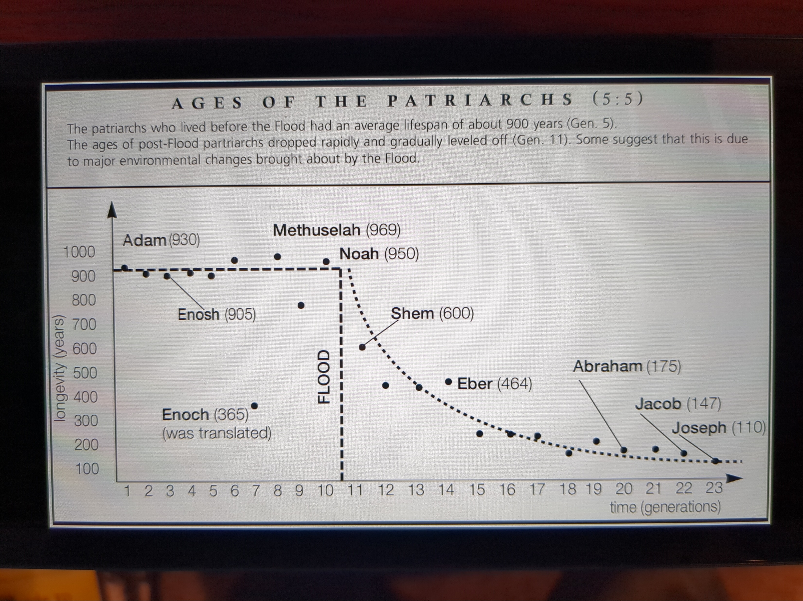
An Interesting Visual of Historical Longevity

Slide 22
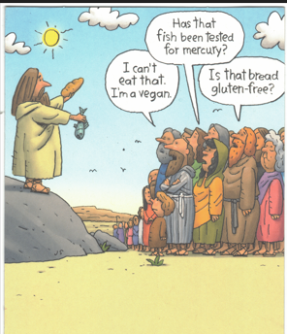
Square One
So, the debate between plant based only diets and plant/animal diets will persist until we are given a “new heaven and new earth”!

Slide 23
Square One (cont’d)
I personally believe the “new heaven and new earth” will be the fulfillment of Yahweh’s desire for what Adam failed to do…and that is to extend the Garden to encompass the whole earth!
When that happens, we know that the “wolf will lie down with the lamb” and the “calf and the young lion together” (Isaiah 11:6)
All this to say that perhaps Plan A was, and still is, the superior plan

Slide 24
Plan A or Plan B which shall it be?
Wanda and I have been following the Chris Wark, Square One diet/lifestyle for over a year now.
Square One is based on Yahweh’s Plan A
Science shows that Yahweh’s Plan A is the fastest way to restore the human microbiome
Wanda and I have had such amazing results that we believe Plan A is an excellent solution for health and longevity
However, we see so many examples in the history of Yahweh’s people of meat being included in people’s diet.

Slide 25
Plan A or Plan B which shall it be? (cont’d)
Yeshua ate fish and even broke the fish and loaves to feed the 5000.
King Solomon’s diet was high percentage meat
The priests were given the select parts of the sacrificed animal
A recent book entitled “The Biblio Diet” by Jordan Rubin and Josh Axe makes a strong case, with personal healing testimonies, for a diet that includes animal products
Certain cultures, like the Eskimos and the Maasai African tribe are nearly 100% meat eaters. However, the life span of these people is less than the norm. One investigator said one Eskimo tribe he studied had a life span of only 34 years.

Slide 26
Plan A or Plan B which shall it be? (cont’d)
However, there is very strong evidence that a plant-based diet is superior.
The Blue Zones video shows a common theme among the 5 locations. That theme being a primarily plant-based diet with a point being made that these locations have some of the healthiest and longest living people on the planet
Dr. Weston Price travelled the world in the early 1900’s in an attempt to discover the healthiest diet. His results, which are totally inconsistent with today’s Weston Price Foundations teachings, were the same as what Dan Buettner found. He also made another interesting observation. Plant-based cultures were more congenial, joyful, and peace loving than animal-based cultures.

Slide 27
Plan A or Plan B which shall it be? (cont’d)
Dr. T. Colin Cambell, a highly regarded biochemist from Cornell University wrote “The China Study” book in 2005. This book was based on research he and a colleague from Oxford University did where people from a variety of villages throughout China were studied. The result clearly showed that a plant-based diet was the healthiest.
Two studies, one, the AHS-1 which started in 1974 and the other, AHS-2 which started in 2002 have tracked 130,000 participants for over 20 years. These studies carefully looked at the percent of animal consumption by the participants. The results showed that those with 5% or less animal consumption were the healthiest and longest living. Those with very high percent animal consumption fared the worse.

Slide 28
Plan A or Plan B which shall it be? (cont’d)
A very recent documentary made by Dr. Michael Greger makes a very compelling case for the benefits of a plant-based diet – especially for brain health and heart health. “How Not to Die” NutritionFacts.org (https://www.youtube.com/watch?v=R2mevFTWsTM)
My conclusion is that Yahweh has allowed Plan B but perhaps only because at the time and location the wide variety of fruits and vegetables needed for Plan A were not available. However, with today’s transportation systems most people can get access to a vast cross-section of plant-based products…Plan A is now possible.
I am feeling better than I have for 50+ years using Plan A. Wanda has turned the corner and is healing from cancer. Both of us have weathered several significant flu outbreaks in our community without getting sick.

Slide 29
Plan A or Plan B which shall it be? (cont’d)
I consider the remarkable results I’ve experienced over the last 14 months as further evidence of the validity of a WFPB diet.
  Before starting the WFPB diet I was taking nearly 50 supplements per day in an attempt to resolve:
    SIBO (Small Intestine Bacterial Overgrowth)
    IBS (Irritable Bowel Syndrome)
    Near debilitating leg cramps at night
    Rising PSA and concern about possible prostate cancer
    Very thin skin that would peal back and bleed for a long time after a minor injury
    Poor sleep
    Anxiety
  Now I take none of those supplements and all these listed issues have resolved. I still have the voice issue that started about 25 years ago but I’m believing it will eventually resolve.

Slide 30
Diet Recommendation
My recommendation for health and longevity includes a Whole Food Plant Based diet
What is a Whole Food Plant Based (WFPB) diet?
It is perhaps the simplest diet of all. Just imagine yourself in the Garden of Eden and ask yourself what would you eat.
You don’t need to concern yourself with counting calories, you don’t need to worry about eating too much fat, you don’t need to worry about eating too much sugar laden fruit. (I’ll explain why later)

Slide 31
What a WFPB Diet Is and What it Is Not
A WFPB diet consists of plant based whole foods.
  Plant based: That means it does not use any animal related items, e.g. no meat, no dairy, no eggs.
  Whole food: This means the entire food item, not an extracted or refined portion. For example, refined sugar, as already mentioned produces a product that is heavily glucose without the rest of the plant fiber to go with it. Refined flour removes the bran and germ from the wheat grain. This leaves the wheat without many important vitamins and minerals.
  When eating a WFPB diet it is desirable to choose a food item that has not be tampered with by other means also. Most plant-based foods are things that have reproductive capability. For example, a plain walnut has the capability of growing a walnut tree if planted. However, a roasted and salted walnut does not have that capability. So, a plain walnut is healthier than a roasted/salted walnut.

Slide 32

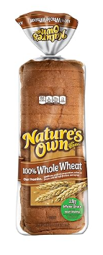
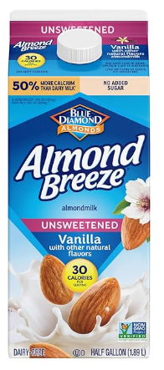
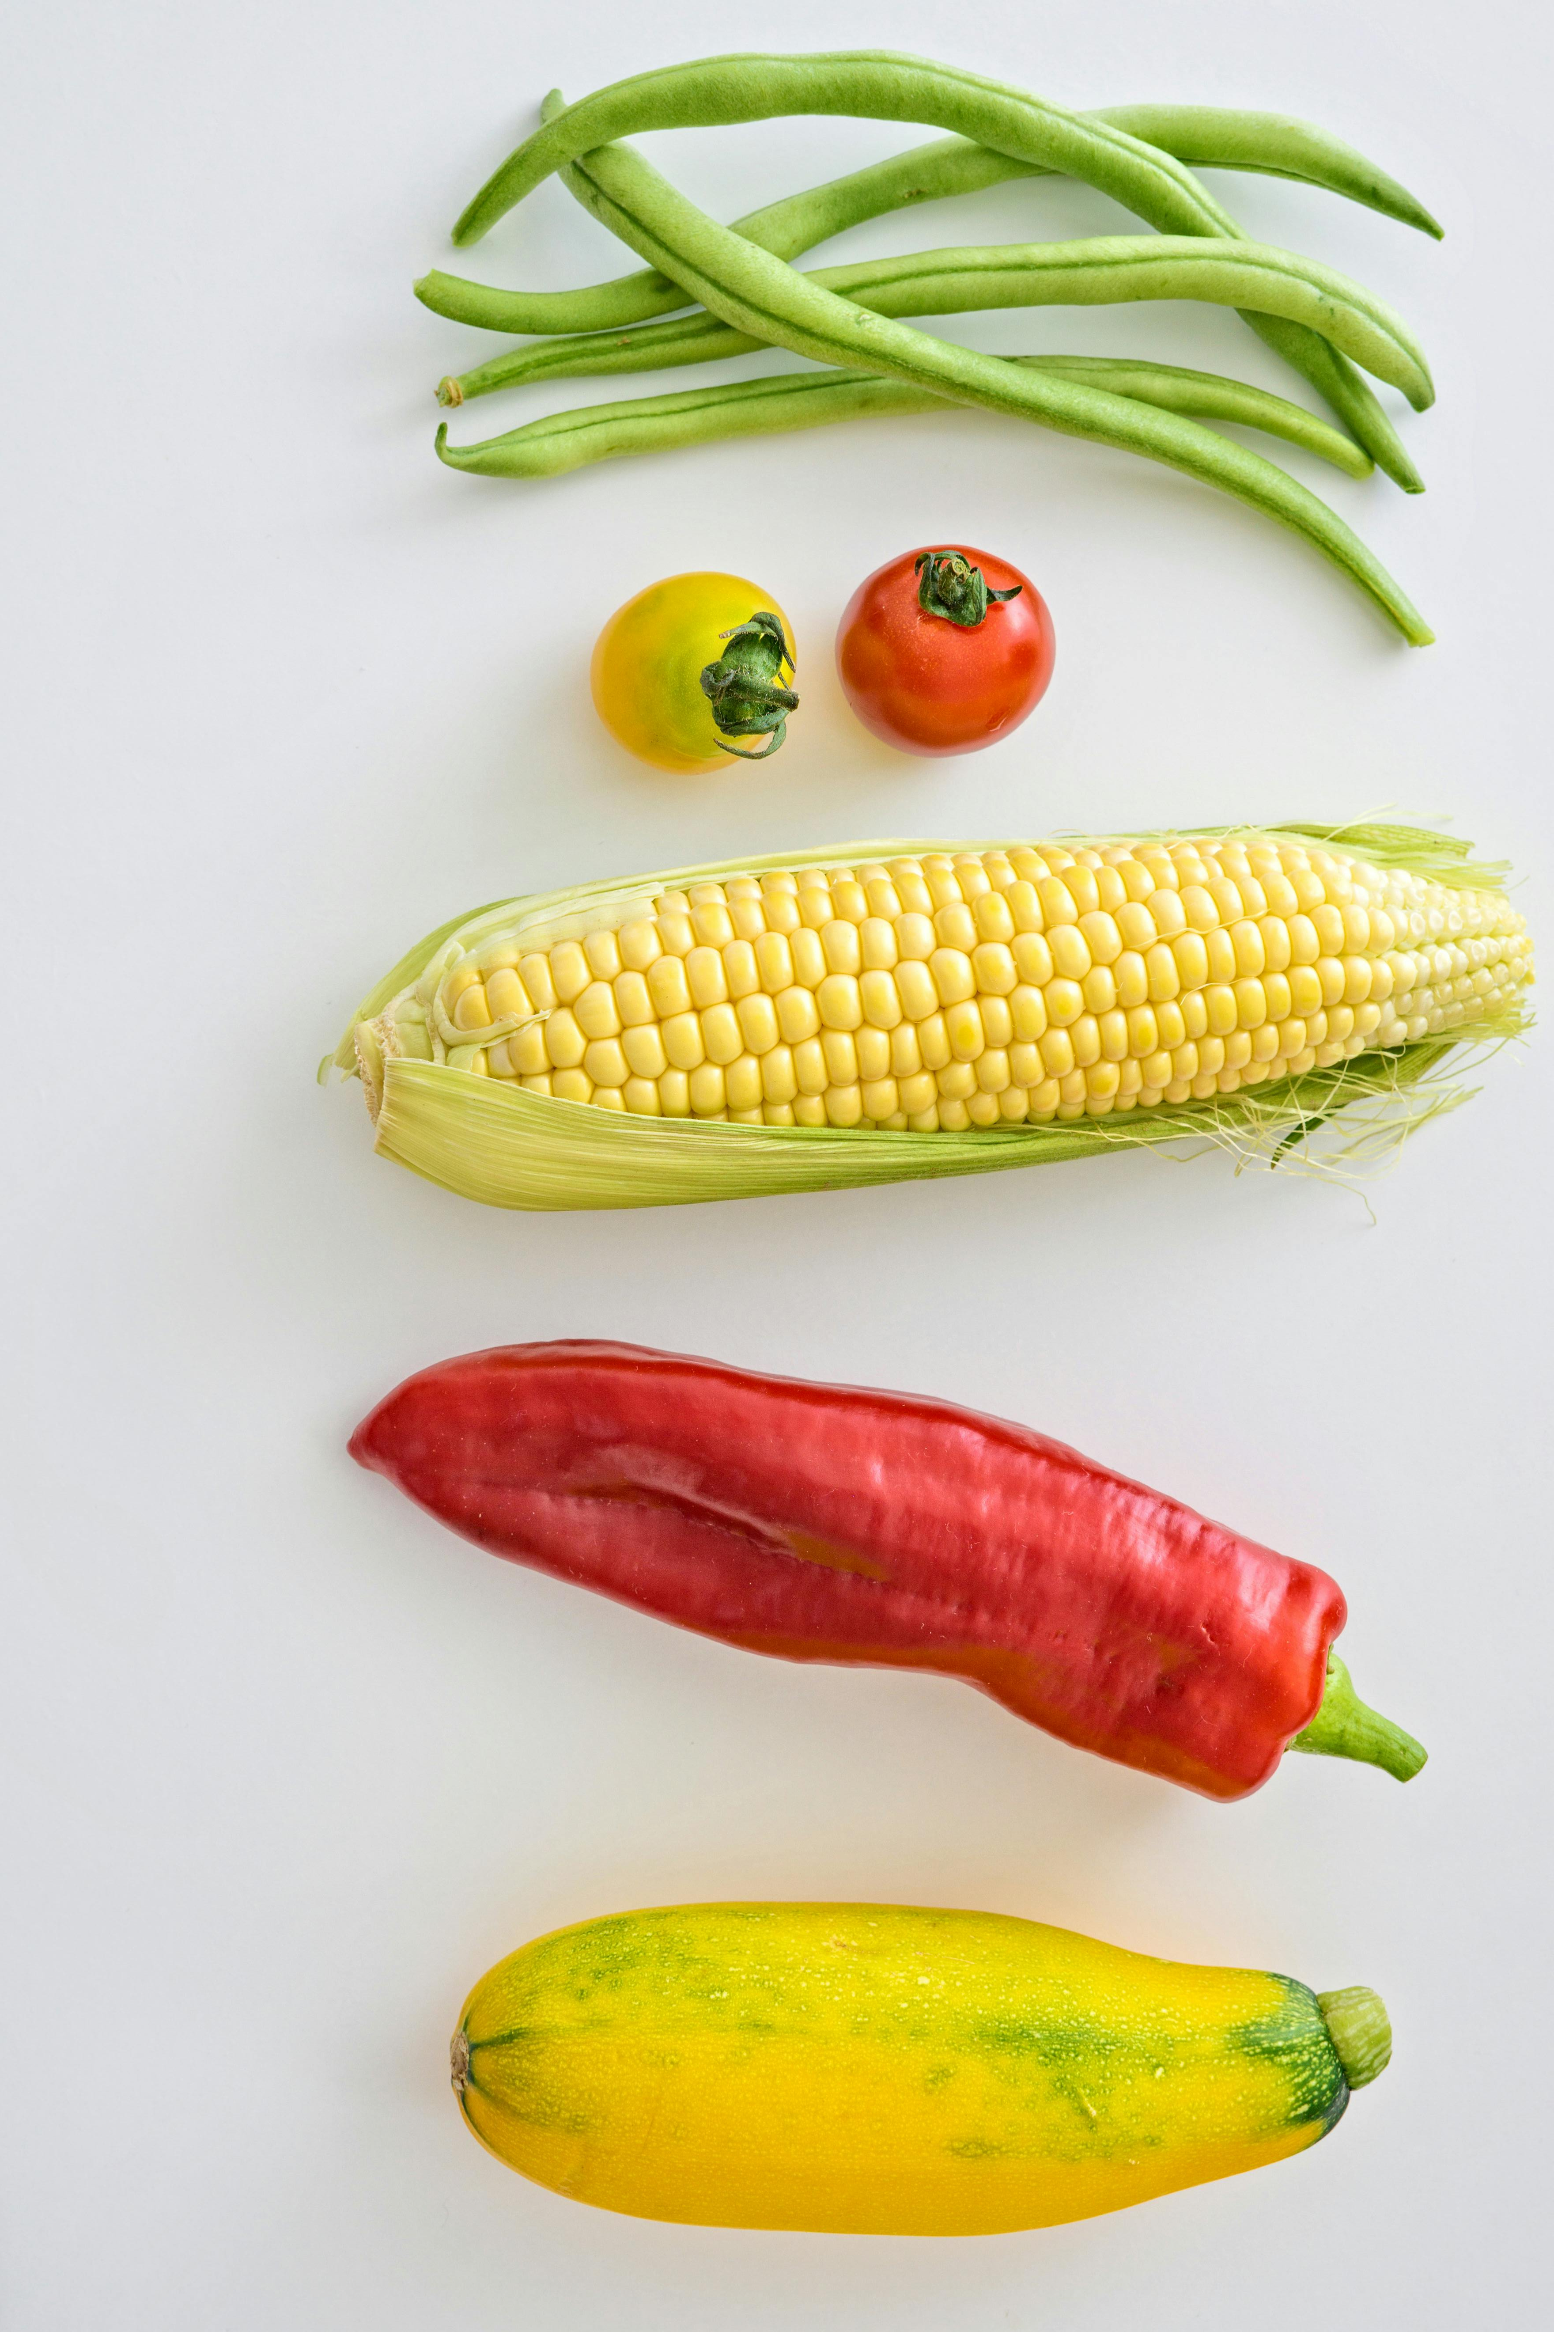
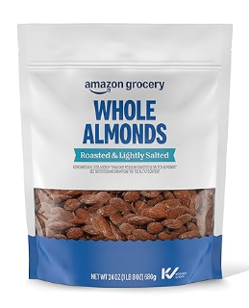
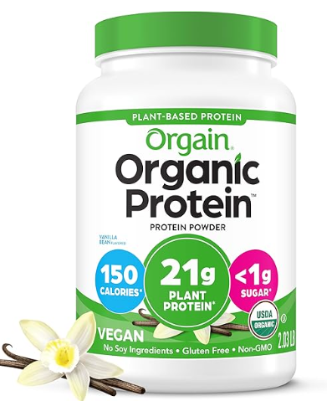
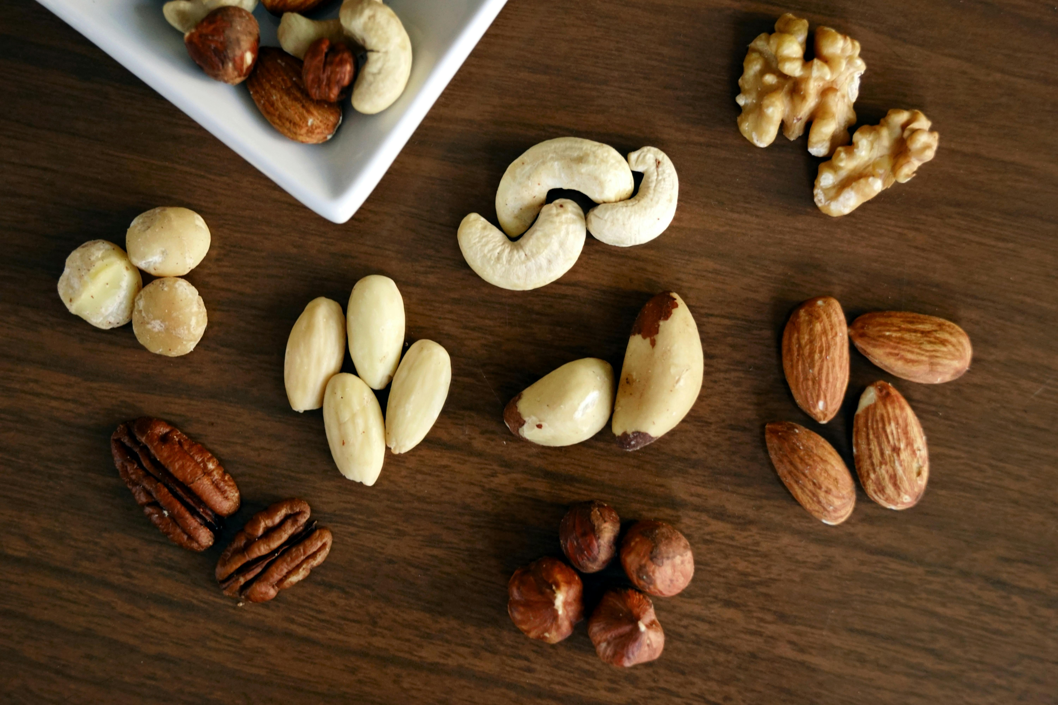
WFPB food selection
YES
NO
Notes:
Whole Food” means the real, unmodified plant. For example you can plant an almond seed and it will grow an almond tree. It has life in it. However, if you roast and salt an almond it won’t grow and almond tree….so we want the the living food.
Blue Diamond Almond Milk: natural flavors, sea salt, sunflower lecithin, gellan gum, etc
Nature’s Own Whole Wheat bread has brown sugar, salt, soybean oil, soy lecthin, distilled monoglycerides, etc

Slide 33
So, What’s the Science behind a WFPB diet?
As mentioned previously our health is directly tied to the health of our microbiome
Our microbiome is made up of “good guy” microbes and “bad guy” microbes.
Most of us who have been eating the Standard American Diet (SAD) are very, very deficient in “good guy” microbes. This is why the health of our society is declining. Disease sets in and there is no one there to fight it. It becomes chronic.
A WFPB diet which is made up of primarily raw foods provides the very best materials for growing “good guy” microbes

Slide 34
Our cancer coach is a microbiologist who works in a hospital medical lab where her job is to identify the pathogens (“bad guys”) that are causing a patient’s disease.
She grows these pathogens on petri dishes so she can determine what the pathogen is and then determine what antibiotic will kill it.
Her observation over many years of doing this is that to grow the pathogen (“bad guy”) you need an amino acid (like what you get from animal protein) substrate. Otherwise, the “bad guys” won’t grow.
In order to grow the “good guys” you need to use a plant-based substrate! They simply won’t grow on an animal-based substrate.
So, in order to restore our microbiome, we need to eat a primarily plant-based diet.
Furthermore, the diet needs to be mostly raw since cooking removes some of the important enzymes for “good guy” growth.

Slide 35
The Immune System
Your immune system is a network of organs, cells, tissues, and molecules that are designed to defend the body against the “bad guys” (bacteria, viruses, fungi, and parasites).
Your immune system relies heavily on the health of your microbiome for its health.
This is why a WFPB diet is the best way to not only restore the health of your microbiome but also restore the health of your immune system.
Your vagus nerve is part of your immune system. Stimulating your vagus nerve also helps improve immune response.
  Messaging your vagus nerve by rubbing in the hollow place just behind/below your ear
Other ways to improve immune response
  Contrast showers – 3 minutes as hot as you can take/ 30 seconds as cold as you can take, repeat 3 times
  Inhaling or applying topically peppermint or lavender essential oil

Slide 36
The Immune System (cont’d)
In a later section I’ll discuss man-made toxins with suggestions on how to avoid and detox from them.
However, it is important to note that natural occurring toxins (flu, measles, colds, etc.) are actually our friends. These “bad guys” help us by keeping our immune system strong!
  When you get a cold or flu it is best to let it run its course rather than trying to medicate it. By letting it run its course your immune system is strengthened! Only if the fever exceeds 104 deg should you try intervention.
  In like manner, it is important that we don’t go overboard with our concern about sterilizing our world! Germophobia and the resulting sterile environment will cause our immune system to get very weak.
  Children playing in dirt is a very healthy activity since it builds their immune system!
The next section will deal with man-made toxins. These, unlike the natural occurring toxins, need to be removed from our environment.

Slide 37
Other Dietary Comments
1) All plant-based food items you consume should be free of herbicides, pesticides, and other “bad guy” destroying compounds. The best way to ensure this is to get organic produce. If you can’t do that then wash non-organic produce in ozonated water or a baking soda/water solution (1 tsp baking soda/2 cups water).
2) If you’ve chosen to include meat items in your diet then make sure the meat is from grass fed cattle which have not been treated with antibiotics or growth hormones.
3) It’s a good idea to get a CBC blood test and Omega-3 test from time-to-time to confirm your diet is keeping your levels proper. You can get these tests on your own without going through a doctor and they are quite reasonably priced.
4) Be careful about using supplements. If you’re not keeping your levels proper then it would be good to tweak your diet rather than using supplements.
5) Probiotics are not helpful! Probiotics are loaded with select microbial species with the intent to give the body a kick start in the area where it’s weak. However, the select species load will overwhelm the other bacterial species and drive them out. A recent study showed surgery patients who had taken antibiotics recovered their microbiome in 1 month without taking probiotics whereas those who used probiotics took 6 months.

Slide 38
Other Dietary Comments (cont’d)
6) Better than probiotics is to regularly eat an apple and a potato that has been cooked then cooled. An apple contains 100 million “good guy” bacteria and the cooled potato provides the fiber to feed the “good guys”. Just make sure you eat the whole apple, core, seeds and all..except the stem of course.
7) The only supplement recommended is Vitamin D. Although certain animal products provide Vit D, the Standard American Diet prevents those products from really doing their job. Most people on the SAD diet have Vit D levels well below optimum. To maintain a strong immune system, it is important to keep your Vit D levels between 70 and 90. Less supplementation is needed when you are able to get substantial sunshine during the day.

Slide 39
But Diet is Only One Part of the Story
Regardless of the disagreement about what diet is best, there is near full agreement within the natural health community about several other pieces to the health and longevity puzzle. These are the other components of a healthy lifestyle:
Oral Health, Toxins, Shalom, Sleep, Sunlight, Exercise

Slide 40
Lifestyle: Diet, Oral Health, Toxins, Shalom, Sleep, Sunlight, Exercise
Our oral health is just as important as our gut health.
Our mouth is part of our microbiome and contains almost as many “good guy”/”bad guy” microbes as our gut
Some of the “bad guy” microbes are the fusobacteria which are responsible for colon cancer and the p.acne bacteria which are responsible for prostate cancer.
So just as it is important to make sure the “good guys” are strong and healthy in the gut, we need to take the same care with our oral health.
A WFPB diet is great for our oral health. Wanda and I have learned what others have learned….tartar buildup on the teeth is much less, almost non-existent with a WFPB diet.
It is important to select a holistic dentist if you need a root canal or tooth extraction. Root canals that aren’t done very carefully can allow some residual bacteria in the canal. Since the canal is closed up it is very hard, almost impossible for the immune cells to get to it. All the while it is spewing “bad guys” into the blood stream.
The same is true of an extraction. The place in your jaw where the tooth was removed will close over and produce what is called a “cavitation”. This, like the root canal can be a place where “bad guys” thrive and wreck havoc on the rest of your body.

Slide 41
Lifestyl: Diet, Oral Health, Toxins, Shalom, Sleep, Sunlight, Exercise
It’s very important to use caution when selecting toothpaste since most toothpaste additives are harmful to the “good guy” bacteria.
I like Christopher’s Herbal Tooth and Gum Powder which is made from herbs only.
Chris Wark believes that it’s the brushing action alone that cleans our teeth, so he says that no toothpaste is needed. However, he would recommend baking soda over any of the other marketed toothpastes if a person felt they needed a toothpaste.
I also like the practice of oil pulling. It strengthens the “good guys” and helps kill and remove the “bad guys”.
For those who really want to be radical and have a concern about the microplastics in conventional toothbrushes you can get a boar’s hair tooth brush from Amazon. I like those and believe they do a good job.

Slide 42
Lifestyle: Diet, Oral Health, Toxins, Shalom, Sleep, Sunlight, Exercise
  Toxins are substances, usually man-made, that when put in contact with the body cause the immune system to respond in an attempt to rid them from the body
  This puts an extra load on the body’s immune system such that it has limited capability to deal with the normal pathogens of life.
  If this toxic load becomes too great for too long the body will succumb to the normal pathogens of life and fall into chronic disease

Slide 43
Lifestyle: Diet, Oral Health, Toxins, Shalom, Sleep, Sunlight, Exercise
Many food additives are toxic and detrimental to our health. It is important to carefully read the ingredient list on any product you purchase. Food additives either destroy the “good guys” or grow the “bad guys” or both. Some of these are:
Natural Colors
  Most of these have been shown to promote cancer
Natural Flavors
  The FDA has permitted the food industry to not disclose the source of these additives.
  Most come from questionable sources. For example, the strawberry flavoring for ice cream and other foods usually comes from castoreum which is a substance secreted by beavers from a gland near their anus to mix with their urine for marking their territory. Although it is natural since it comes from an animal it contains a number of toxic compounds.

Slide 44
Lifestyle: Diet, Oral Health, Toxins, Shalom, Sleep, Sunlight, Exercise
Added Sugar
  Added sugar is refined sugar. Unlike the sugar found in the whole food (for example sugar cane or fruit), refined sugar lacks the fiber, vitamins, and minerals found in the whole food. As a result, it causes blood sugar problems that can lead to diabetes, metabolic syndrome, etc..
  Purchasing food that contains “added sugar” puts you at risk
So does this mean that a person should go on a low carb or keto diet?
  No, as mentioned in the following slide our bodies need glucose to be healthy
  The Square One diet uses carrot juice which is highly concentrated healthy sugar to supercharge the immune system in order to overcome serious disease like cancer.
  Out of the 400+ long term cancer survivors in Jodi Ledley’s database, only 1 or 2 used Keto as their strategy. The vast majority had carrot juice as part of their healing strategy.
  Cancer “bad guys” can outlive their host by 5 years or more! So if you try to use a Keto strategy for your illness you’ll likely die before your “bad guys” do!

Slide 45
A note about sugar
Sugar has been greatly vilified in the last 50 years. It has been accused of causing cancer, heart disease, diabetes, and other conditions.
It is true that refined sugar causes a number of health problems like those mentioned. However, sugar in its whole food form (like fruits and carrots) is very important for the health of our microbiome. The “good guys” and the immune cells all need the glucose from sugar to be healthy and strong. Robbing the body of healthy sugar spells trouble down the road.
When eating a whole food plant-based diet there is no need for concern about blood sugar spikes. Spikes are normal for everyone who eats carbs of any sort. What is important is the “fasting glucose” number. A person eating a WFPB diet will have their fasting glucose number well in the proper range regardless of how much fruit they eat.

Slide 46
A note about sugar (cont’d)
The reason for this is has to do with what causes cardiovascular problems and diabetes problems.
It all has to do with fat build-up in the arteries and on cell-wall insulin receptors.
Fat build-up in the arteries causes cardiovascular problems
Fat build-up on the cell’s insulin receptors causes the cell not to be responsive to insulin. Since insulin is the signal for the cell to accept glucose from the blood this causes the blood sugar problems that people with diabetes or metabolic syndrome deal with.
So, what causes these fat build-ups? It’s not the type of fat, rather it is the presence of “bad guy” bacteria that are hanging around the artery walls and the insulin receptors on the cells. These “bad guy” bacteria capture and retain the fat molecules as they pass by in the blood stream.
So, here’s another case where a WFPB diet comes to the rescue since it is all about increasing “good guys” and decreasing “bad guys”
Notes:
Refer again to Dr. Greger’s documentary!

Slide 47
Lifestyle: Diet, Oral Health, Toxins, Shalom, Sleep, Sunlight, Exercise
Artificial Sweetners
  1) Aspartame (used in diet sodas, also known as Nutrasweet, Equal, or Sugar Twin) is believed to cause liver cancer and activate glutamate causing neurological issues as well as impairing brain function. It appears that the babies of mothers using aspartame can develop Metabolic Syndrome and Obesity.
  2) Sucralose (Splenda) came as a byproduct of an insecticide development and because of its toxicity was never intended for human consumption. It has been shown to upset sugar handling in the body and worsen gut inflammation in people dealing with Crohn’s disease.
  3) Saccharin (Seet’NLow) has been found to damage the gut’s “good guys” potentially resulting in Diabetes, Obesity, and Cancer
  4) Sugar Alcohols (Xylitol, Erythritol, Sorbitol, etc.) are extensively processed sugar substitutes usually derived from GMO sources. They are known to cause certain allergies, SIBO, rashes, bloating, etc..

Slide 48
Lifestyle: Diet, Oral Health, Toxins, Shalom, Sleep, Sunlight, Exercise
Glutamate
  Glutamate is a very important amino acid in the human body. It acts as a neurotransmitter to facilitate the communication within the body and brain.
  Glutamate levels are very carefully controlled by the body to prevent things like epilepsy, stroke, Alzheimer’s, and Parkinson’s
  When Glutamate is added to food it upsets that perfect balance and becomes a neurotoxin. Our cancer coach was debilitated for many years before she learned to eliminate all glutamate food additives from her diet.
  Glutamate is found in lots of food additives, not the least of which is MSG (monosodium glutamate)
  The next slide has a list of some of the glutamate containing food additives. After looking at this slide you’ll be inclined to choose to simply not allow any food additives in the products you purchase!

Slide 49
Lifestle: Diet, Oral Health, Toxins, Shalom, Sleep, Sunlight, Exercise
Food additives that contain glutamate are:
  MSG, Yeast extract, Soy Protein, Calcium glutamate, Yeast Nutrients, Soy Protein concentrate, magnesium glutamate, anything “Hydrolyzed”, Monopotassium glutamate, anything “Protein Fortified”, Autolyzed plant protein, Whey Protein, Textured Protein, Whey protein isolate, Calcium caseinate, anything “Enzyme Modified”, Gelatin, Vegetable protein extract, Protease, Natural flavors, “Flavoring”, Malted barley, Malt extract, Maltodextrin, Anything “Ultra-Pasteurized”, Oligodextrin, Brewer’s Yeast, Carrageenan, Barley Malt, Caramel coloring, “Seasonings” (if not labelled individually), Smoke flavoring, Dough conditioners, Amino Acids (e.g. Braggs), Soy Sauce, Soy extract, Protein powders, corn starch, High-fructose corn syrup, Balsamic vinegar, Gums (guar, xantham, etc.), Most things that are “Low Fat” or “No Fat”, Rice syrup, Corn syrup

Slide 50
Lifestyle: Diet, Oral Health, Toxins, Shalom, Sleep, Sunlight, Exercise
Processed Vegetable and Seed Oil
  There’s considerable debate within the natural health community about vegetable and seed oils. Some of this debate revolves around the fact that many of these oils contain linoleic acid which is considered bad for our health.
  Linoleic acid is inherently not bad. It is found in many vegetables and seeds and when consumed as the whole food are actually good for our health.
  The issue really has to do with processing the vegetable or seed oils.
  Processing changes the properties of the oil and when heat is used the molecular structure will be changed to the point where the end product is very toxic.
  So, the bottom line to this discussion is: Processed oils are very toxic. However, unprocessed (virgin and cold pressed) oils are very good for our bodies. We should not be afraid of any oil that is organic, virgin, and cold pressed as long as we store them properly and don’t cook with them. These oils contain the healthy fats that our bodies need.

Slide 51
Lifestyle: Diet, Oral Health, Toxins, Shalom, Sleep, Sunlight, Exercise
Environmental Toxins
  Drinking Water
    Whether city water supply or well water beware of toxins (chlorine, herbicides, etc.)
    Best filters: Berkey, Reverse Osmosis – both are good and equal in performance
  Physical contact with: Insecticides, Herbicides, Motor oil, Gasoline, Mercury
    Take care to use personal protective equipment
  Toxic fume inhalation
    Exhaust from automobile, lawn mower, etc.
    Soldering and welding (heavy metal exposure)
    Synthetic scents used in perfumes and colognes
  EMF
    Cell phone radiation – harmful to health especially when kept close to the body
    WiFi routers in home or office – especially harmful to health. Radiation is strong and always present. We’ve replaced WiFi with wired (ethernet) at the Farm.

Slide 52
Lifestyle: Diet, Oral Health, Toxins, Shalom, Sleep, Sunlight, Exercise
Environmental Toxins (cont’d)
  Hand Sanitizers & Public Facility Hand Soap
    Beware of hand sanitizers. Most contain toxic chemicals and although you might get your hands clean, you’ll be killing lots of “good guys” in your skin microbiome.
    Same comment about public facility hand soap. If you need to wash your hands use a tiny amount of soap but scrub your hands by rubbing them together with water very well.
  Personal Care products
    There are very few personal hygiene products that are healthy. If you look at the ingredients in most such products you will see lots of questionable chemicals.
    On the Chris Beat Cancer website you can find a list of the products that he endorses as being healthy.
    Better still, our friends at Deep Well Botanicals sell very pure, herbal based personal care products.

Slide 53
Lifestyle: Diet, Oral Health, Toxins, Shalom, Sleep, Sunlight, Exercise
Environmental Toxins (cont’d)
  Personal Care products (cont’d)
    However for those items that Deep Well doesn’t carry I like Dr. Bronner’s “All-In-One” bar soap. And for shampoo and conditioner I like the Purador products
    Most sunscreens do more damage than good due to their toxic ingredients and also due to their suppression of the sunlight that produces the beneficial Vit D3.
  Home Maintenance products (cleaners, laundry & dish detergents, etc.)
    Same comment as Personal Care products. When putting your hands in dish water everyday or putting your hands in a bucket of cleaning solution for household cleaning, you sure don’t want to be putting a bunch of harmful chemicals on your skin microbiome
    Again, Chris Beat Cancer website has recommendations for healthy alternatives
    I like the Truly Free brand. They are expensive but they are always having special sales with competitive prices.

Slide 54
Lifestyle: Diet, Oral Health, Toxins, Shalom, Sleep, Sunlight, Exercise
Environmental Toxins (cont’d)
  Food packaging and storage products
    The plastics that are used for packaging and storing food and water are somewhat chemically unstable meaning that the plastic material will leach into the food or water over time. This is particularly concerning when the plastic is highly toxic like BPA
    However, another concern has recently surfaced. That has to do with microplastics being ingested when eating or drinking a product that has been stored in plastic containers. There are some current theories about how microplastics may be responsible for a number types of cancer and Alzheimer’s disease. They are finding microplastics in people’s brains.
    So, it is best to use glass, ceramic, or stainless steel where possible for storage. For cooking, cast iron is proabably the best.

Slide 55
Lifestyle: Diet, Oral Health, Toxins, Shalom, Sleep, Sunlight, Exercise
Detoxing
  In our toxic world it is important to be proactive about detoxing our body
  Detox strategies
    Sauna or 45-minute hot bath – the key is profuse sweating
    Healthy pooping and peeing
    Rebounder for 10 minutes – puts the lymphatic system to work
    Water fast for 3 to 5 days, repeat every 3 to 5 weeks – this is very good
    Eating garlic and/or cilantro will detox heavy metals
    Coffee enema – this has been the go-to for a long time but now we are wondering about whether it might be killing the “good guys” as well as the “bad guys”. Not sure…

Slide 56
Lifestyle: Diet, Oral Health, Toxins, Shalom, Sleep, Sunlight, Exercise
Difference between man-made toxins and natural occurring toxins
  Our body is designed to handle natural occurring toxins like the flu virus or measles or a cold or even MRSA. However, it is not designed to handle man-made toxins like those mentioned previously.
  It is important to note that we do ourselves a big disservice if we become germophobic and attempt to make our personal space so sterile that no natural occurring toxins are permitted. As mentioned before, it takes the natural occurring toxins to keep our immune system challenged and strong.

Slide 57
Lifestyle: Diet, Oral Health, Toxins, Shalom, Sleep, Sunlight, Exercise
Shalom peace is perhaps even more important than diet for good health and longevity
Shalom peace comes from a right relationship with Yahweh, yourself and others
Forgiveness tops the list of things that help produce shalom peace in our hearts.
  Bitterness toward others, toward Yahweh, and/or toward ourselves is a poison. Chris Wark wants to be remembered, not so much for his Square One diet plan, but for his teaching on forgiveness. He encourages his listeners to regularly go to God, ask Him to reveal all people who they are holding unforgiveness toward and then sincerely forgive that person.

Slide 58
Lifestyle: Diet, Oral Health, Toxins, Shalom, Sleep, Sunlight, Exercise
Community
  Yahweh has ordained for us to live in community. The sense of belonging in a multi-generational community where we can give and receive brings fulfillment and a sense of shalom peace.
Joy
  A subset of the result of belonging in community, joy is the inner strength we need to deal with the issues of life from a place of peace.
Sense of Purpose
  Yahweh created us for a purpose. He gave us a destiny. When we know our purpose and are walking in it, we experience peace.
Cast your cares on Him
  Anxiety is deadly. It keeps us in a fight-or-flight posture. While in fight-or-flight mode our body shuts down certain functions while energizing other functions. Functions critical to our long-term health, such as the immune system, the digestive system, and the excretory (bowel and kidney) system are slowed. If we stay anxious for any length of time our health is compromised.

Slide 59
Lifestyle: Diet, Oral Health, Toxins, Shalom, Sleep, Sunlight, Exercise
Cast your cares on Him (cont’d)
  Yeshua said we are to cast our cares on Him. There are so many verses on this subject…”be anxious for nothing but by prayer and supplication, with thanksgiving, let your requests be made known to Him” (Phil 4:6-7)
  Consider all the other verses and examples in scripture where we are admonished to not be afraid.
  He knows we are prone to living in fear and He knows this is not at all good for us!
  When we are in shalom our body responds by bringing the health and healing functions back on line and recovery from illness kicks in.
  Many, including myself, have experienced a natural reduction in stress simply by removing the food additives and processed food from our diet.

Slide 60
Lifestyle: Diet, Oral Health, Toxins, Shalom, Sleep, Sunlight, Exercise
Good sleep is very important to health and longevity.
Sleep is where most of the body’s recovery takes place and where toxins are removed from the brain
Contrary to what some say, everyone needs at least 7 hours of sleep each night for recovery and detox to take place.
When we do sleep it needs to be healthy sleep. We need to thoroughly go through the 4 stages of sleep with ample time in each.
Deep sleep is where most of the healing and brain detox takes place.
REM sleep is where the filing cabinets in our brain get sorted and put in place so we can tackle the new day with a clean slate.

Slide 61
Lifestyle: Diet, Oral Health, Toxins, Shalom, Sleep, Sunlight, Exercise
Good sleep only happens when we honor the circadian cycle of our 24-hour day.
Yahweh designed our body to release the cortisol hormone for daytime activity and to release the melatonin hormone for nighttime sleep.
As our day begins cortisol is released and we find ourselves waking up and getting energized for the day’s activities. As the day closes melatonin is released and we find ourselves slowing down, getting tired and ready for bed.
It is important for us to be intentional about protecting our body from the things that hinder the natural circadian cycle.

Slide 62
Lifestyle: Diet, Oral Health, Toxins, Shalom, Sleep, Sunlight, Exercise
Things that hinder our circadian cycle and cause poor sleep are:
  Variable sleep times and variable wake times
  Lack of exposure to the natural sunlight that Yahweh designed to reset our circadian cycle each day
  Forcing ourselves to defy the circadian cycle by keeping our mind engaged in work or intense video drama within an hour or two of bedtime
  Artificial light.
    Yahweh gave us the sun which, during the hours we usually work puts out a lot of blue and ultraviolet light. The blue light stimulates cortisol production in our body so that we are energized for the work at hand.
    Artificial light (light bulbs or light strips) in our homes is primarily blue wavelength which means that even as we move into late afternoon and evening our body is being triggered to release cortisol which keeps us “wired” instead of being prepared for sleep.
    I use a pair of inexpensive blue light cancelling glasses when doing work or reading in the evening

Slide 63
Lifestyle: Diet, Oral Health, Toxins, Shalom, Sleep, Sunlight, Exercise
As mentioned in the sleep section, Yahweh intends for our circadian cycle to be reset each day with natural sunlight
There is something about the early morning sunlight and late evening sunlight that are very therapeutic to our body.
The early morning and late evening sunlight is primarily infra-red. Infra-red light has a lot of health benefits including resetting the circadian cycle.
Since infra-red light doesn’t go through window panes very well but does penetrate clouds and clothing, I recommend 10 minutes of outside sunlight exposure, morning and evening regardless whether it is cloudy or cold.
Mid-day sun is important to stimulate the production of Vit D3. The use of sunscreen thwarts this healthy function and as mentioned in the “Toxin” discussion, sunscreens are particularly toxic to our skin microbiome.
  The notion that overexposure to sun can cause cancer is not correct. Yes, it can damage our skin but the thought that it causes melanoma is false. Most melanoma cases are in places where there is typically very little sun exposure.
  I recommend limiting your exposure to prevent burning otherwise enjoy all the unprotected sunlight you want.

Slide 64
Lifestyle: Diet, Oral Health, Toxins, Shalom, Sleep, Sunlight, Exercise
Exercise is another key to health and longevity.
The Dan Buettner video shows the very active lifestyle that is characteristic of each of the 5 Blue Zone societies.
Yahweh intended us to be active since he told Adam to tend the garden and expand it.
Our bodies were created for movement and we do so much better when we are moving. Blood circulation, breathing function, muscle tone, and bone health all do much better when we keep ourselves in motion. Our bodies are 60% water. Water becomes stagnant if it isn’t moving!

Slide 65
Lifestyle: Diet, Oral Health, Toxins, Shalom, Sleep, Sunlight, Exercise
My recommendations for exercise
  Walking is perhaps the best overall exercise. Walking outdoors, especially at a park or a place of nature, adds more value. We get fresh air, can refocus our attention on nature and experience a break in the busy-ness of the day. This can help us return to shalom. I suggest at least 8000 steps per day.
  Resistance training, like weight lifting, is very helpful. Weight lifting not only strengthens the muscles but strengthens and heals the bones. This is very important as we age and especially for women past menopause. Weight lifting is better than any calcium or other bone health supplement.
  High Intensity Interval Training (HIIT) strengthens and heals the cardiovascular and respiratory system. HIIT is done by running, rebounding, or any other activity that raises your heart rate. Run (or other activity) as hard as you can for 30 seconds, then walk (or other light movement) until your heart rate comes down to the point where you’re able to repeat the 30 second intense activity. Repeat this 6 times. You should eventually be able to have your rest time decrease to lower than 90 seconds.
  Where possible, stand instead of sit, while doing desk work.

Slide 66
So where does all this leave us?
Considering all that has been shared so far it is obvious that we, as a society, have deviated far from Yahweh’s lifestyle intent.
I recently read a book entitled “Deceived by the Machine” which shares how the coming great deception is most likely coming in the form of a beast system made up of an AI facilitated global structure that removes personal liberty in favor of safety, convenience, and supposed well-being.
I believe, in a similar way, we are being deceived by the swan song of a system that is luring us to value convenience, dining experience, comfort, quick-fixes, etc. over the things that Yahweh values.
Go to a shopping center or shopping district in your community. There you’ll find clothing stores, hardware stores, technology stores, etc. Look around and you’ll also see lots of restaurants. Unless there is a Chipotle in the vast group of restaurants, you’ll be hard pressed to find one that serves unadultered whole food.
If you’re like Wanda and I, when we try to go out to eat or travel, we suddenly wake up to the extent to which we’ve been deceived by the hidden agendas of our modern society.

Slide 67
What to do?
It’s time to take ownership of our health!
It’s time to come out of the Bablyon of our cultural norms and expectations.
It’s time to return to Yahweh’s plan for the stewardship of our physical being.
It’s time to take the priestly responsibility for leading our family out of this cultural Babylon.

Slide 68
Some Practical Suggestions
Lifestyle
  Hopefully you’ve been able to come up with some personal lifestyle strategies from the material presented: forgiveness and other shalom producing activities, ridding you diet and environment of toxins, habits that facilitate quality sleep, exercise routines, etc.
Diet Options
  Serious Chronic Disease
    Based on our personal experience and the documented experience of many others I recommend the Chris Wark Square One diet for people dealing with significant chronic disease. It is a big commitment but will reap a big reward of giving your life back to you.
  Health and Longevity
    For those not dealing with a serious chronic disease but are wanting to steward their body well.

Slide 69
These two diets are WFPB
Regardless which diet you choose you’ll want to include the following:
    Cruciferous veggies
    Leafy green veggies
    Root veggies
    Bulb veggies
    Night shade veggies
    Legumes
    Nuts
    Seeds
    Oils
    Fruits
    Herbs and Spices
    Herbal teas
    Each of these promote “good guy” growth and many will kill “bad guys”!

Slide 70
Serious Chronic Disease Diet
Chris Wark’s Square One diet
  If you’re dealing with a significant chronic disease (cancer, heart disease, diabetes, NAFLD, metabolic syndrome, MS, autism, Alzheimer’s, lupus, osteoarthritis, etc., I recommend something similar to Chris Wark’s Square One diet.
  This diet is designed to both supercharge the immune system and at the same time restore the body’s microbiome.
  It is a big commitment but if done consistently will resolve most any chronic condition more fully than any medical intervention, supplements, or other diet plan.

Slide 71

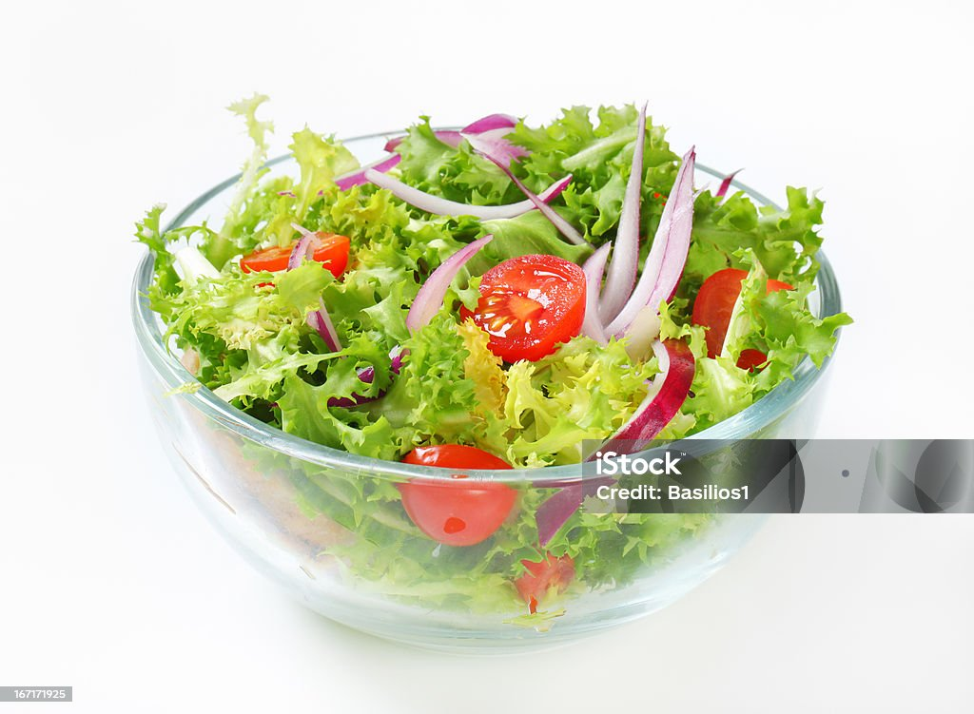
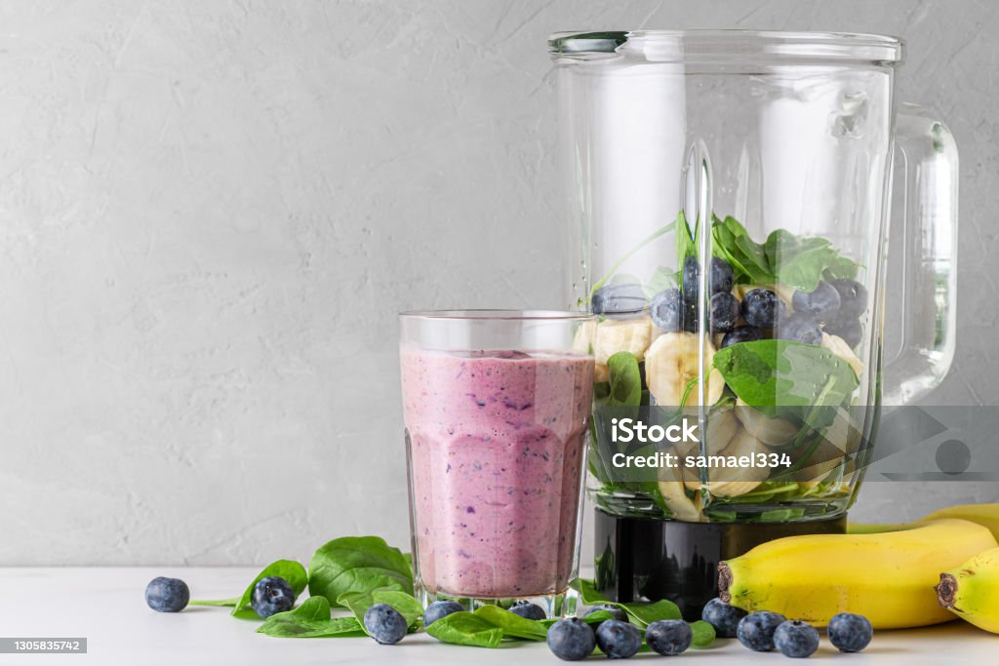
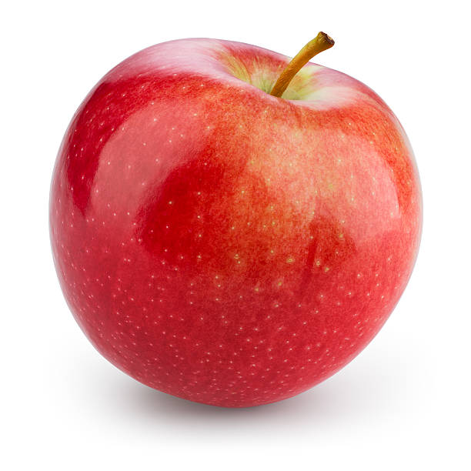
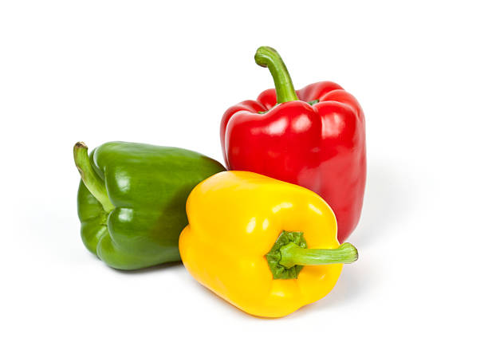

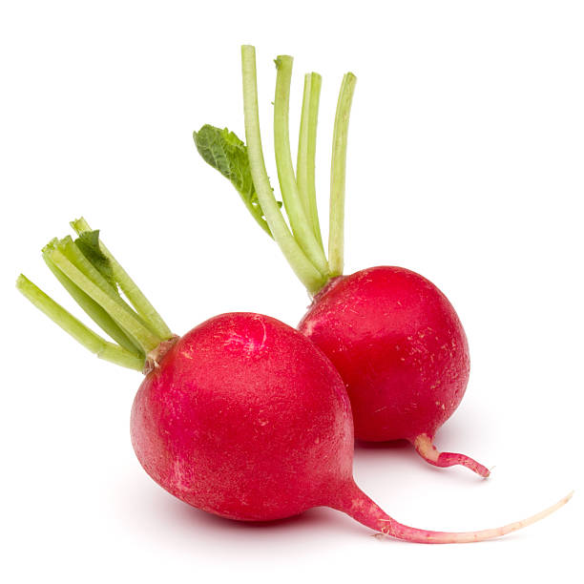
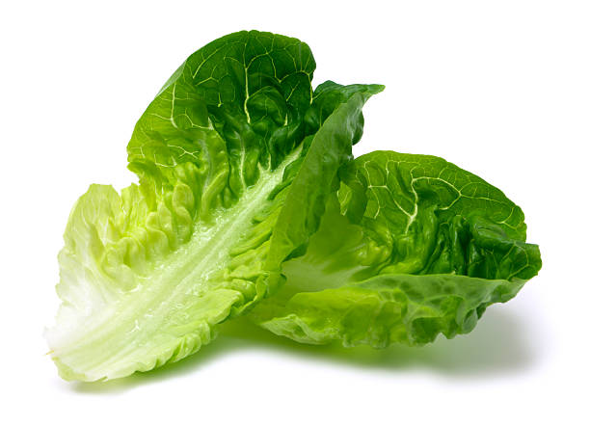
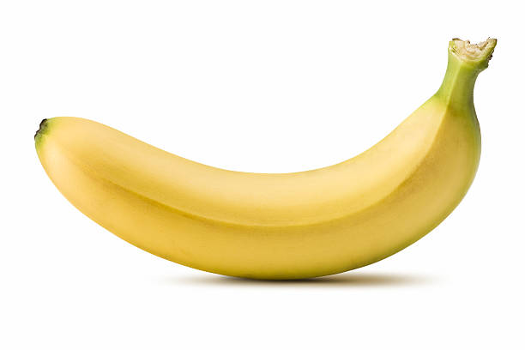
Square One Diet
Supercharge Immune System & Restore Microbiome
Large Salad
32+ oz Smoothie
Large Salad
Note: If attempting to heal from a serious chronic disease, I recommend connecting with a Square One health coach. Every disease needs a unique strategy to deal with the “bad guys” while growing the “good guys”.
40+ oz Carrot/Celery
Juice
Snacks – Any fruit or veggie

Slide 72
Health and Longevity
Greg’s Recommended Health and Longevity Diet
  This diet is intended to restore and maintain your microbiome.
  It is designed around Yahweh’s Plan A
  It has a well researched and proven track record
  It’s not difficult but certainly is a huge paradigm shift from what we are used to.
  It does require commitment since years of dietary habit will make it hard to do this for the long haul.

Slide 73

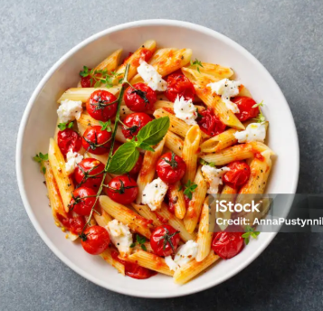
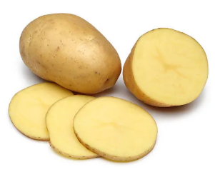
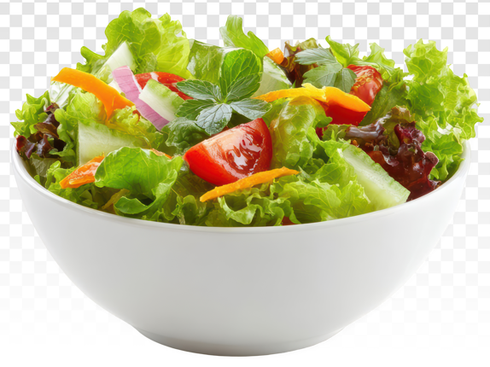
Greg’s Longevity Diet --
Maintain great health
WFPB Breakfast
Large Salad
32+ oz Smoothie
Cooked veggies, legumes or Soup
Snacks – Any fruit or veggie
Side Salad

Slide 74
Greg’s Longevity Diet -
Maintain great health
32+ oz smoothie
Large salad(s) with Olive Oil or WFPB salad dressing
Find a way to add 1 Tbsp each of: softened chia seeds, hemp seeds, and fresh ground flax to the food you eat each day.
Be creative with plant based whole foods for the rest of meals
Some ideas (proven recipes)
  Waffles: homemade almond flour, chia seeds, etc.
  Pot Roast: selected mushrooms instead of meat
  BLTs: use Jodi’s “baken beets” in place of bacon
  Buckwheat bread: buckwheat, honey or maple syrup, water
  Jodi’s Flavor Bombs: roasted cheery tomatoes, garlic, black pepper, olive oil
  Date Balls: dates, walnuts, cinnamon, nutmeg
  Soups: all kinds of vegetable soups
  Other ideas: contact me (greg.triplett@ourfathersfarm.org)
  Many other recipes are available in “Chris Beat Cancer Kitchen” book available on Amazon

Slide 75
Large Salad and Smoothie Details
  Make a large salad (one that could be considered a whole meal)
    Choose from the attached list of examples of veggies: cruciferous, leafy green, root, bulb, night shade, legumes
    Make sure to get a good cross section of some from each category
    Make sure to get a good cross section of color. One adage says “eat the rainbow”
    Add to the above 1-2 Tbsp of no-additive, fermented sauerkraut
    For people fighting a serious chronic disease, add 1-2 Tbsp of broccoli and/or radish sprouts. Also add the “bad guy” fighting sprinkle made up of a variety of herbs and spices
    Drizzle with extra virgin olive oil
  32 oz Smoothie
    Several fruits of your choice (the whole fruit with the exception to remove peel from banana)
    A handful of leafy greens (several types from the leafy green list)
    Water (or herbal tea(s)) as base
    ¼ tsp Amla powder, ½ tsp Moringa powder
    Optional for even better health: ¼ tsp Black Cumin Seed, Brown Mustard seeds (amount to your liking)

Slide 76
Examples of:
  Cruciferous veggies
    Broccoli, Cauliflower, Brussel sprouts, Kale, Green cabbage, Red cabbage, Bok Choy
  Leafy greens
    Spinach, Kale, Swiss Chard, Arugula, Beet Greens, Lettuce, Beet greens, Radish greens, Dandelion greens, Plantain greens, Mullein leaf
  Root veggies
    Turnip, Radish, Carrot, Rutabaga
  Bulb veggies
    Onion, Garlic,
  Night Shade veggies
    Potato, Tomato, Red Bell Pepper, Yellow Bell Pepper, Orange Bell Pepper, Eggplant
  Legumes
    Black beans, Lima beans, String beans, Lentils, Peas, Chickpeas,

Slide 77
Examples of:
  Nuts (plain, unsalted)
    Pistachios, Walnuts, Pecans, Hazelnuts, Brazil nuts (go easy on these), etc
  Seeds
    Chia, Flax, Hemp, Sesame, Apricot Kernels, etc
  Oils (use only extra virgin, do not cook with these)
    Olive, Coconut, Flaxseed, Sunflower, Sesame, Canola (make sure this is organic)
  Fruits
    All fruits, anything goes!
  Herbs & Spices
    Oregano, Parsley, Thyme, Cinnamon, Turmeric, Garlic, Cumin, Black Pepper
  Herbal Teas
    Dandelion root, Burdock root, Sheep sorel, Licorice, etc..

Slide 78
One Other Diet Option
If you just can’t “stomach” a diet without animal products then I recommend the Mediterranean diet. This diet emphasizes whole food fruits and veggies while minimizing the amount of animal products.
Cindy Grove has prepared a document containing lots of recipes, most of which fit into the Mediterranean diet category. I will make her list available on the recording link for this conference.

Slide 79
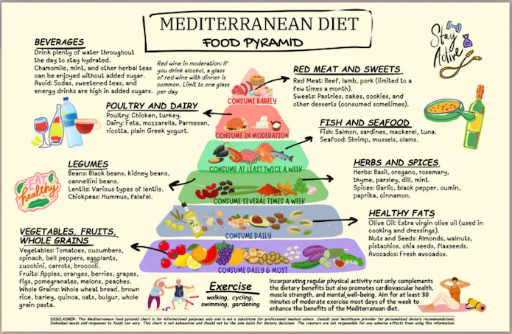

Slide 80
What about the Biblio Diet?
A recent book, “The Biblio Diet” was written by two individuals who obviously love Yahweh and are committed to Him. They use the Bible as their source to propose a diet that appears to be similar to what the Weston Price Foundation promotes. “The Biblio Diet” rightfully identifies bad food additives as well as disallowing unclean animal content. However, there is little evidence that people using this diet are living longer and healthier than people using a WFPB diet. As I’ve shared in this presentation, animal content in our diet will definitely limit our longevity and health. The authors hold up King Solomon as an example of someone who did well on a mostly carnivore diet. However, it is believed King Solomon only lived 80 years which is short compared with other biblical figures.

Slide 81
The Bottom Line
Do your best to remove toxins from your life or at least distance yourself from them
Eat real food rather than processed food
Stay away from processed food
Make sure all the food you eat is clean: organic or washed, if animal – grass fed, antibiotic free, etc.
Make raw food be the majority of the food you eat
Start living in such a way that you are honoring and properly stewarding the body Yahweh gave you.

Slide 82
FAQ’s
  1) How does a person get sufficient calcium if not allowed to have dairy?
    Eating a variety of plants give all the minerals your body needs. In the unlikely event your CBC results show low on calcium a good source is a supplement “AlgaeCal” made from algae. Most people in our WFPB cancer group have not had a problem with insufficient calcium.
  2) How does a person get sufficient protein if not allowed to have meat?
    As with question 1, a variety of plants and seeds provide adequate amount of protein. Chris Wark hasn’t eaten meat for 23 years now. He lifts weights for strength training and is now an Olympic class weight lifter. Some of the largest, strongest animals in the world are plant eaters; the ox, the elephant, the orangutan. If your CBC results show low on protein add in more legumes (black beans, edamame) and/or seeds (chia, hemp, flax)
  3) What other evidence do we have that a WFPB diet is healthy?
    Chimpanzees have a DNA structure that is 99.4% identical to the human DNA. Chimpanzees are plant eaters and even make their own green smoothy by wrapping a piece of fruit in some green leaves and then eating it like a sandwich!

Slide 83
FAQ’s (cont’d)
  4) As we all know, what works for one person doesn’t necessarily work for everyone – so how can you be so sure about the universal benefits of WFPB
    My confidence is based on God’s Word. He knows better than anyone. There was a book written a few years ago entitled “Eat Right 4 Your Type”. That book makes a compelling statement that certain blood types won’t do well on a plant-based diet. The doctor who wrote this book was challenged a few years after he wrote it to show the studies that proved his statement. He has never produced those studies and people’s experiences have not been consistent. For example, my blood type is “O” which means I would need a carnivore type diet. However, I’ve been healthier than I’ve been most of my life for the last 14 months on a WFPB diet
  5) So, what about “eating out”?
    This has been one of the biggest impacts for Wanda and I. Unfortunately, most restaurants aren’t like they were 100 years ago. They serve a SAD diet with lots of processed food with additives and unhealthy fats.
    The only chain restaurant I know of that serves real food is “Chipotle” You may be able to find a local restaurant serving real, whole food. In Kansas City we have “Enjoy Pure Food”.

Slide 84
FAQ’s (cont’d)
  6) All this discussion was about chronic disease, what about acute conditions like pneumonia, ear ache, heart attack, etc.?
    Barbara O’Neill has some excellent teaching on natural health protocols for these and many other conditions. You can find her teaching at: https://www.youtube.com/watch?v=YgjzY6cyXEM
  7) Any more recipe ideas?
    Cindy Grove has put together her recipe book of healthy cooked dishes. Not all are plant based but the ones that aren’t comply nicely with the Mediterranean diet. I’ll provide her document in the link to the recording for this conference.

